Slide 1

Department of Computer Science & Engineering Project Presentation
Zomato Data Analysis and Rating Predictor
Project By
AF0378108 – Goutham M P
Guide
Shivakumar Selvam

Slide 2
Index
Introduction
Problem Definition
Scopes
Objectives
proposed System
Methodology
Outcome
Conclusion
References

Slide 3
INTRODUCTION
Introduction To Data Science and Machine Learning
Data science combines statistics, computer science, and domain knowledge to extract valuable insights from data, aiming to make data-driven decisions and solve problems.
Machine Learning is the field of study that gives computers the capability to learn without being explicitly programmed. ML is one of the most exciting technologies that one would have ever come across.
Machine learning algorithm is used to draw inferences from datasets consisting of input data without labeled responses.

Slide 4
PROBLEM STATEMENT
Predict restaurant ratings based on factors like location, cuisine, and average cost.

Slide 5
SCOPE
The scope outlines the boundaries and focus of the project. For a Restaurant Rating Prediction project, the scope might include:
Data Collection: Gathering restaurant-related data, including user reviews, restaurant information, and historical ratings from various sources and platforms.
Data Preprocessing: Cleaning, transforming, and organizing the data to make it suitable for analysis and modeling.
Feature Engineering: Selecting and creating relevant features or attributes, such as cuisine type, location, sentiment analysis of reviews, and historical ratings.
Model Development: Building and testing machine learning or predictive models to forecast restaurant ratings based on the chosen features.
Evaluation and Validation: Assessing the model's performance through various metrics, such as Mean Absolute Error (MAE) or Root Mean Square Error (RMSE), to measure accuracy and reliability.

Slide 6
OBJECTIVE
The objectives define the goals and outcomes the project aims to achieve. For a Restaurant Rating Prediction project, the objectives might include:
Accurate Rating Predictions : To create a model that accurately predicts restaurant ratings based on various factors, allowing users to make informed dining choices.
Improved User Experience : Enhancing the dining experience by providing users with predictive ratings and insights before they visit a restaurant.
Insightful Recommendations : Offering personalized restaurant recommendations to users based on their preferences and historical ratings.
Data-Driven Decision-Making : Enabling restaurant owners and managers to identify areas for improvement by analyzing predictive factors that influence ratings.
Research Contribution : Advancing the field of restaurant rating prediction by exploring novel features, models, or approaches and contributing to the existing literature.
:Practical Application : Creating a real-world application or tool that can be used by consumers and restaurant stakeholders to make data-driven decisions.

Slide 7
Proposed System
Proposed system:
Culinary experts provide ratings based on factors like food quality, service, and ambiance.
Collect feedback from customers through surveys and comments.
Consider a restaurant's reputation and longevity in the community.
Ratings are typically found in physical guides with no real-time updates.
To help restaurant startups in Bangalore, we decided to experiment with the Zomato Bangalore Restaurants database, to see if we could draw conclusions about how location, food type, etc could affect the ratings of a restaurant.

Slide 8
METHODOLOGY
Description of the dataset :
The dataset consists of 51717 rows and 17 columns.
Column Description : url : Contains the url of the restaurant in the Zomato website. address : Contains the address of the restaurant in Bangalore.
name : Contains the name of the restaurant. online_order : Whether online ordering is available in the restaurant or not.
book_table : Table book option available or not.
rate : Contains the overall rating of the restaurant out of 5. votes : Contains the total number of rating for the restaurant as of the mentioned date. phone : Contains the phone number of the restaurant. location : Contains the neighbourhood in which the restaurant is located.
rest_type : Restaurant type. dish_liked : Dishes people liked in the restaurant.
cuisines : Food styles, seperated by comma.
approx_cost(for two people) : Contains the approximate cost for a meal for two people.
reviews_list : List of tuples containing reviews for the restaurant, each tuple consists of two values, rating and review by the customer. menu_item : contains list of menus available in the restaurant. listed_in(type) : type of meal. listed_in(city) : Contains the neighbourhood in which the restaurant is listed.

Slide 9
METHODOLOGY
Data Preprocessing : Our data consisted of quite a few null values. To solve the problem of missing values, we followed the following steps :
First we removed all rows containing null values in the ‘cuisines’ column.
For the second step, since the ‘address’, ‘phone’, ‘url’, ‘listed_in(city)’ columns had a lot of null values, we dropped these 4 columns.
The third step was renaming the ‘approx_cost(for two people)’ and ‘listed_in(type)’ columns as ‘average_cost’ and ‘listed_type’

Slide 10
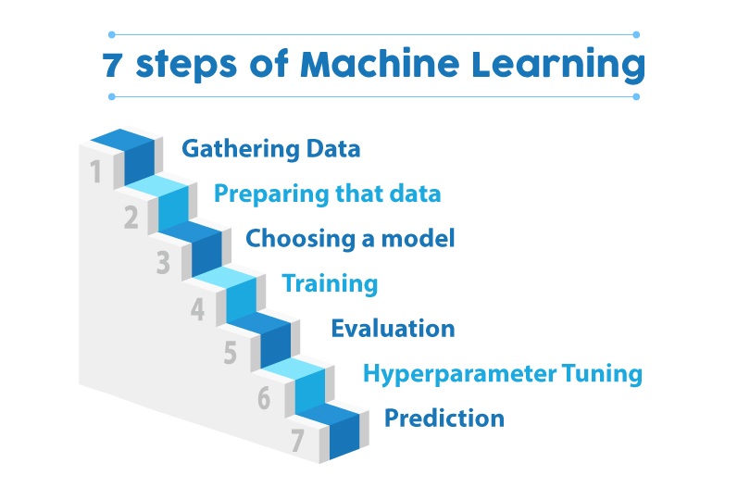
METHODOLOGY

Slide 11
METHODOLOGY
The various regression algorithms used to build the model are : linear regression, random forest regression algorithm, ridge regression, lasso regression, KNN algorithm, Support vector regression (SVR) and Bayesian regression.
Linear regression : Simple linear regression involves only one dependent and one independent variable. It can be represented as :
Y = a + bX (1)
where X is the independent variable and Y is the dependent variable. b represents the slope of the line and a is the intercept.
Random forest regression : The random forest regression algorithm combines the decisions and forms a sequence of base models. The model is formulated as follows :
g(x)=f0(x)+f1(x)+f2(x)+... (2)
where g is the sum of the base models fi.

Slide 12
METHODOLOGY
Ridge Regression : Ridge regression is a variation of linear regression. It is used to solve multicollinearity in multiple regression. The equation for ridge regression is written as :
Y = XB + e (3)
where, Y is the dependent variable, X is the independent variable, B represents the regression coefficients to be estimated and e represents the errors.
Lasso Regression : It is a variation of linear regression that involves shrinkage.
KNN Regression :
A simple implementation of KNN regression is to calculate the average numerical target of the K nearest neighbours.Support Vector Regression(SVR) : SVR is similar to support vector machines with insignificant variance. Eventually, the error is reduced by individualizing the margin.Bayesian Regression : Another variation of linear regression which uses probability rather than point estimates.
After modelling the data, we found that Random Forest regressor fit the best. But to increase the regression score, we used one hot encoding and got a regression score of 93.22.

Slide 13
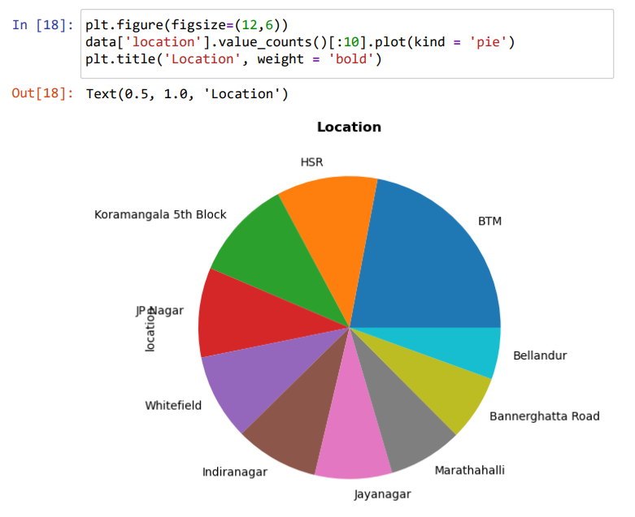
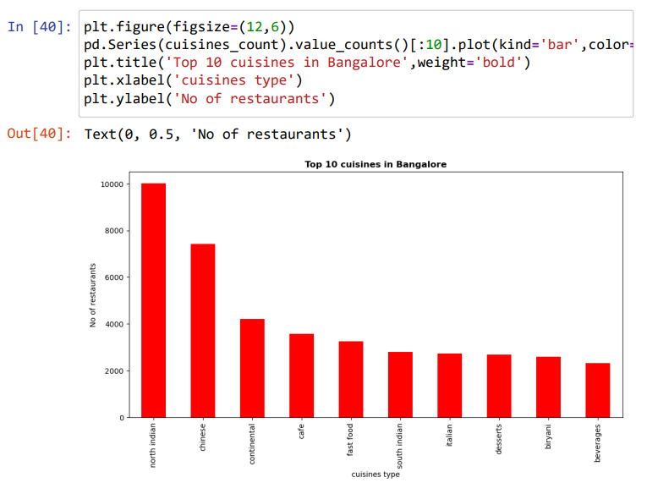
OUTCOME

Slide 14
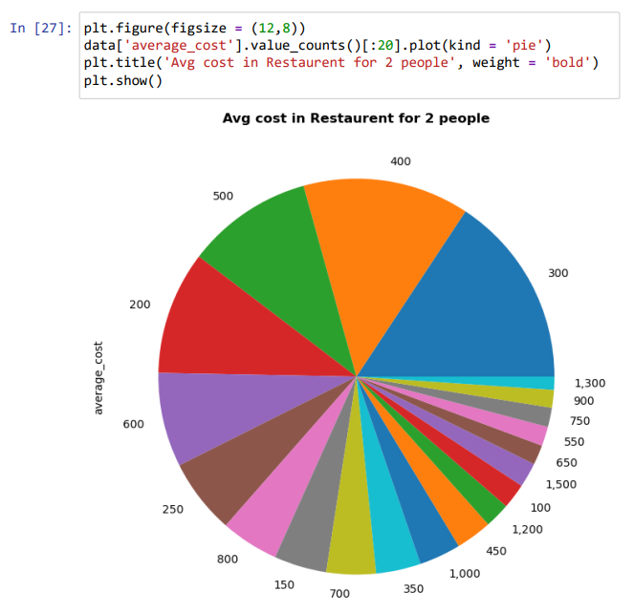
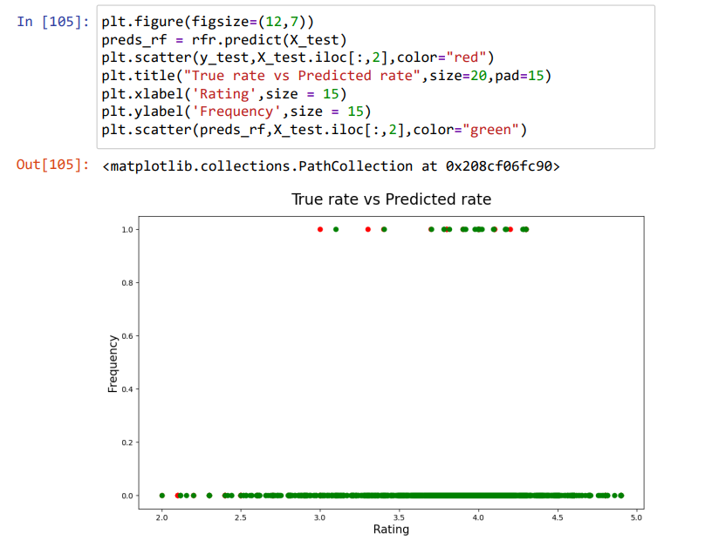
OUTCOME

Slide 15
CONCLUSION
In conclusion, our analysis has shed light on the intricate dynamics that influence restaurant ratings. Through a comprehensive examination of factors such as location, cuisine, and user reviews, we have uncovered patterns and correlations that contribute significantly to a restaurant's overall rating. The geographical proximity, the type of cuisine offered, and the sentiments expressed in user reviews all play pivotal roles in shaping public perceptions.
Our predictive model, developed with meticulous consideration of these factors, demonstrates a commendable level of accuracy in forecasting restaurant ratings. This not only provides valuable insights for restaurant owners seeking to enhance their offerings but also empowers consumers with a tool to make informed dining choices.
However, it's important to acknowledge the ever-evolving nature of the restaurant industry and the dynamic preferences of consumers. As such, continuous updates and refinements to our model will be crucial to maintaining its relevance and reliability.

Slide 16
REFERENCES
https://www.ibm.com/in-en/cloud/learn/machine-learning
https://towardsdatascience.com/churn-prediction-model-8a3f669cc76
https://www.kaggle.com/himanshupoddar/zomato-bangalore-restaurants

Slide 17
THANK YOU

